Slide 1
Integrated Simulation at the Exascale: coupling, synthesis & performance
Stephen Longshaw
UKRI STFC, Daresbury Laboratory
Engineer’s House, 11-12 October 2023

Slide 2
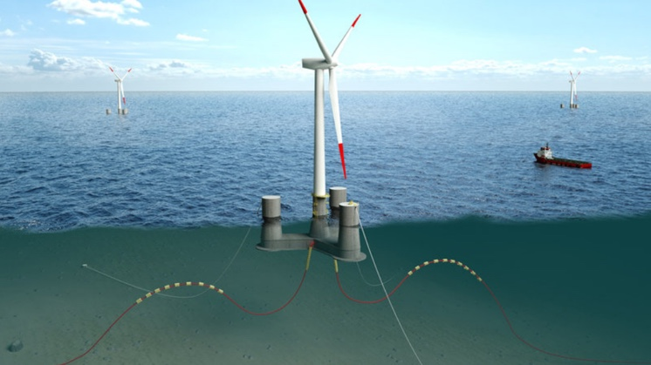
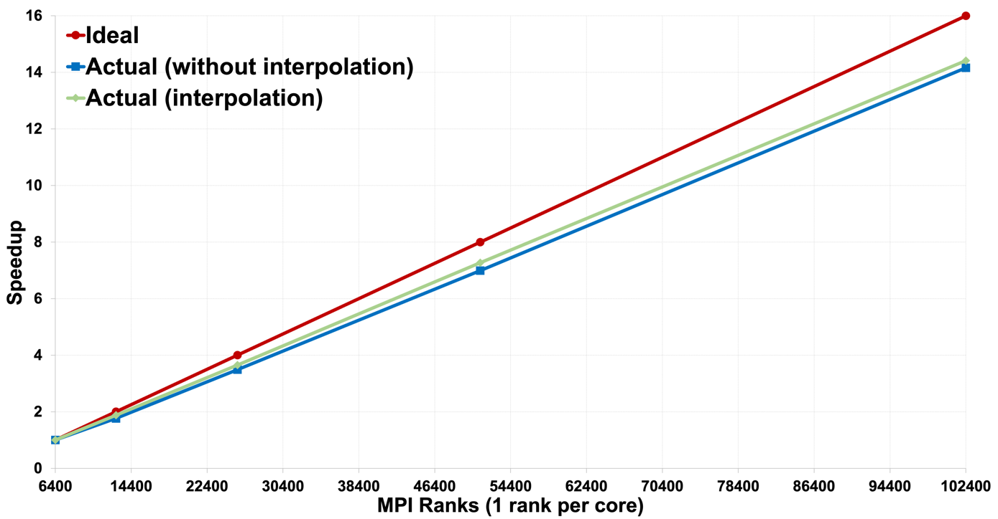
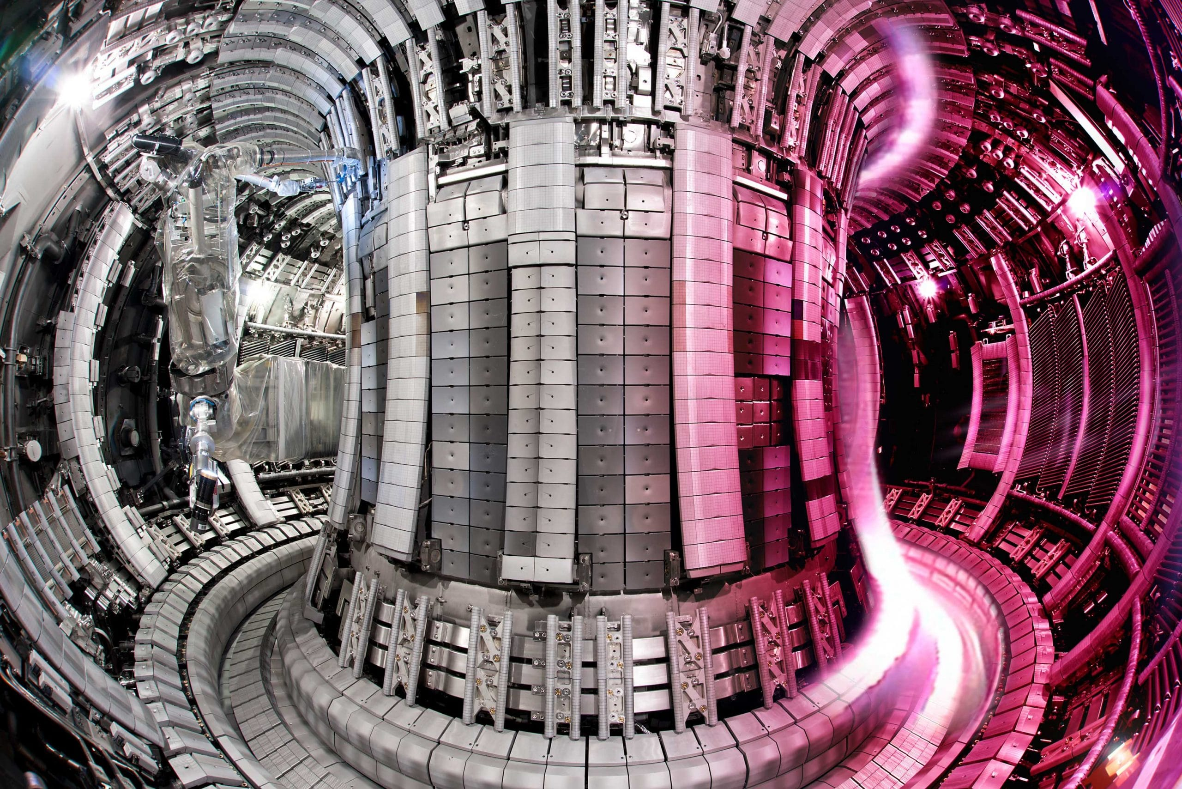
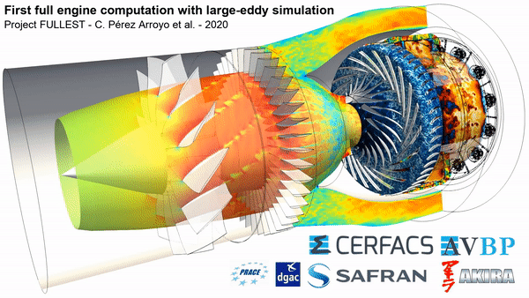
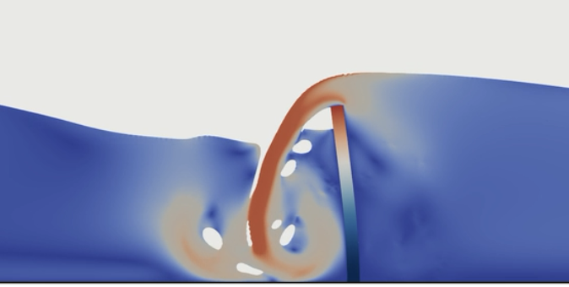
Project Status
Multi-physics/scale simulations at the exascale:
Software (solvers and libraries)
Algorithms and mathematical fundamentals
Reproducibility and distribution
Generalised code coupling software:
Multiscale Universal Interface (MUI)
Header-only C++
MPI inter-solver communications
Self-contained linear algebra
Extensible spatial and temporal data sampling
Anchors (soil-structure)
Flexible tethering
Rigid floating body dynamics
Structural
mechanics
Hydrodynamics and aerodynamics
https://github.com/MxUI/MUI
Granular (soil)
mechanics
Solver development e.g. FEniCSx:
High-performance Finite Element framework
Easily integrated into a partitioned coupled solution
Ideal monolithic multi-physics environment
https://fenicsproject.org
https://github.com/ParaSiF
Notes:
Prompt - presenters should provide a brief reminder (or introduction for new projects) of their project within the talk and direct attendees to posters for further information.
Slide narrative:
General project objectives
Floating offshore wind turbine example:
Represents an example of exascale multi-physics type problems important to UKRI themes like NetZero
Complex multi-physics nature of the overall problem revealed one item at a time
Tokamak and whole jet engine provided as other examples of coupled problems at a similar level of complexity
Core elements of ongoing work then presented:
MUI overview, scalability study from ARCHER2 showing excellent scaling up to 800 nodes for a benchmark coupled problem
Developments and use of FEniCSx in a coupled context
FEniCS as part of the ParaSiF partitioned coupled framework built using MUI
FEniCS used to create a monolithic multi-physics thermal simulation of the feeder blankets in international ITER fusion project

Slide 3
Current Challenges
Cross-project dissemination
This is a cross-cutting project, it is driven by wider scientific problems
Beyond the knowledge-exchange co-ordinator network, what else can ExCALIBUR do to foster dissemination between projects at a programme level?
Would a top-down programme driven approach to project interworking have more impact that the bottom-up project driven approach we currently use?
Insight from the Hardware & Enabling Software stream
We are currently re-writing MUI’s linear algebra capability into native SYCL
Is this a good approach for the future?
Would it be feasible to gather high-level learning from H&ES to direct the software projects within ExCALIBUR?
+
?
Notes:
Prompt – presenters to share ongoing or current barriers faced in the project that would benefit from further discussion or connecting with an individual or project could help to overcome this. This could be a technical barrier, people barrier, not being aware of good practises or needing better connections. These discussions could help push forward progress across the programme and further afield

Slide 4
Questions?
https://excalibur-coupling.github.io

