Slide 1
Knowledge exchange panel
Nick Brown, Jemma Shipton, Joseph Wallwork, Marion Samler, Martin Hamilton
Engineer’s House, 11-12 October 2023

Slide 2
Session plan
To start with a brief update on knowledge exchange across the programme
In the interests of keeping people interested (and awake!) we have picked a few general activities to highlight
Panellists will briefly talk about these (3 to 5 mins each).
To then have a discussion with the audience and panel around knowledge exchange more widely
What is currently going well?
Where can be improve?
What opportunities should we be exploiting that we are currently not?
Lessons to learn from what has been done so far
Notes:
Prompt - presenters should provide a brief reminder (or introduction for new projects) of their project within the talk and direct attendees to posters for further information.

Slide 3
SC22 Birds of a Feather (BoF) session
SuperComputing is the HPC community’s largest HPC conference held in USA with around 15,000 attendees
We held a BoF collaborative session to present the ExCALIBUR programme to the wider HPC audience
Advertised amongst all ExCALIBUR projects, in the end comprised lightening talks from 8 projects (around 5 mins each) followed by an audience discussion
We had around 30-40 attendees, with some good discussions but could have been a bit busier
Were contending with other sessions and lunchtime, retrospectively was probably a bit too UK focussed in it’s description
Other ExCALIBUR activities at SC22 included:
BoF on code coupling run by Stephen Longshaw from STFC as part of the code coupling project
Had a good turnout and involved some really interesting discussions
Research poster for xDSL project
RISC-V BoF
RSE workshop, panel, BoF
Partner booths with ExCALIBUR materials
Such as STFC, EPCC, UCL
Notes:
Prompt – presenters to share ongoing or current barriers faced in the project that would benefit from further discussion or connecting with an individual or project could help to overcome this. This could be a technical barrier, people barrier, not being aware of good practises or needing better connections. These discussions could help push forward progress across the programme and further afield

Slide 4
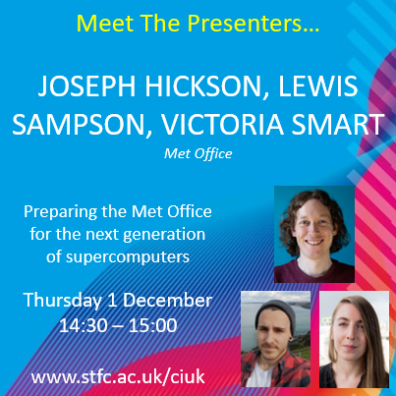
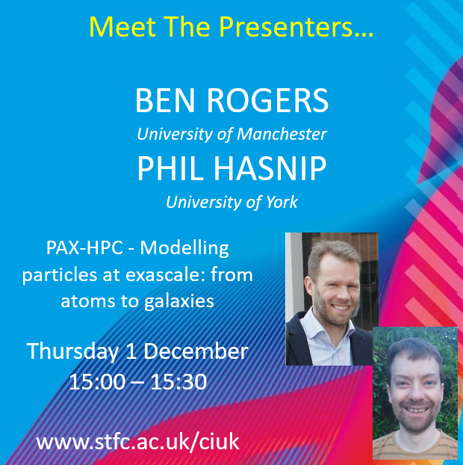
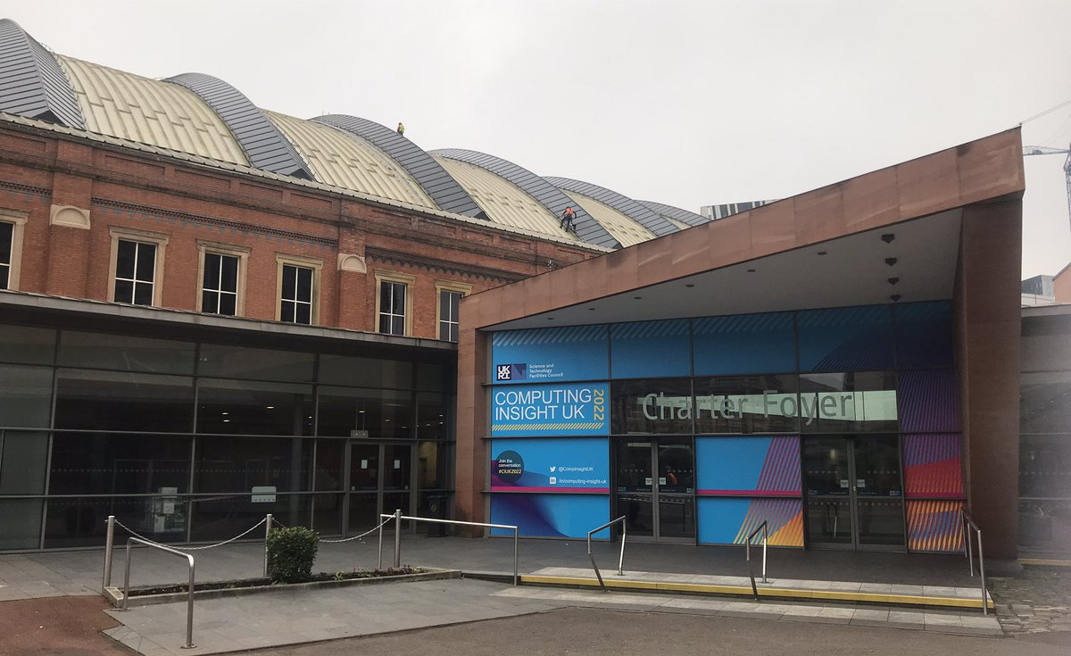
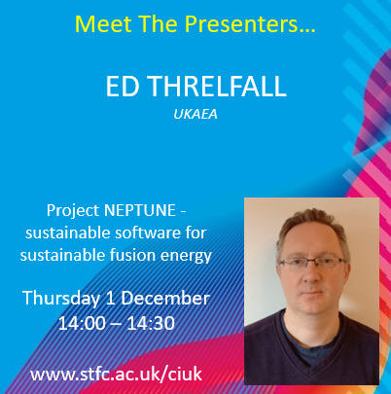
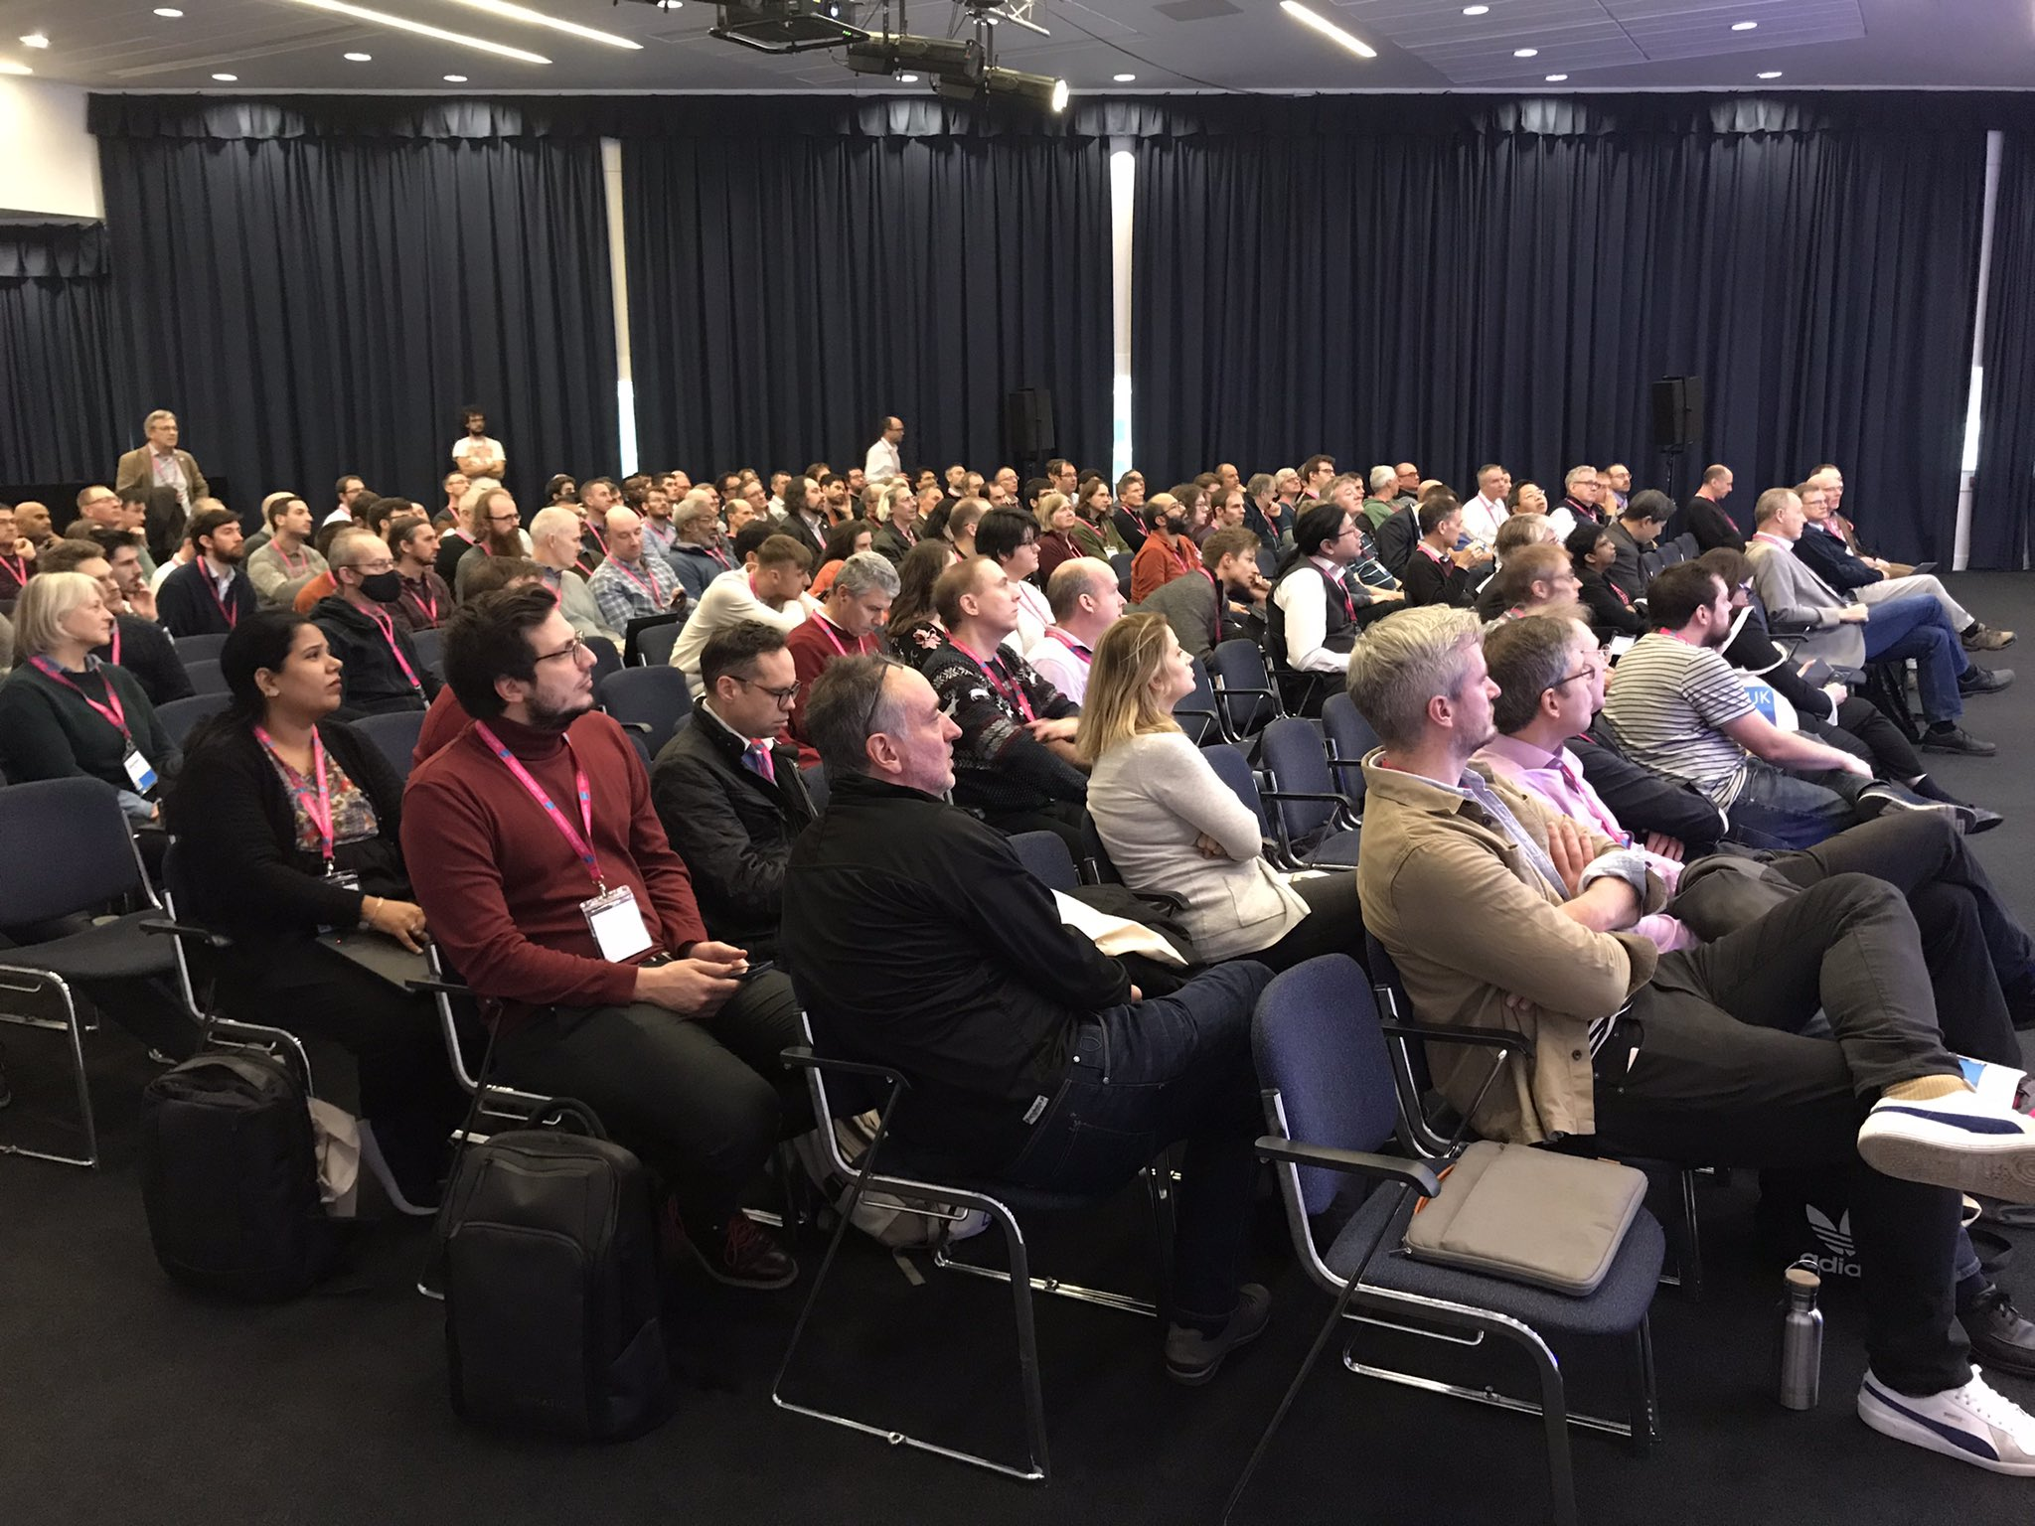
CIUK 2022
Organised by Phil Hasnip and Chris Richardson
ExCALIBUR going to have a significant presence at CIUK 2023 (December 6th, 7th, 8th)

Slide 5
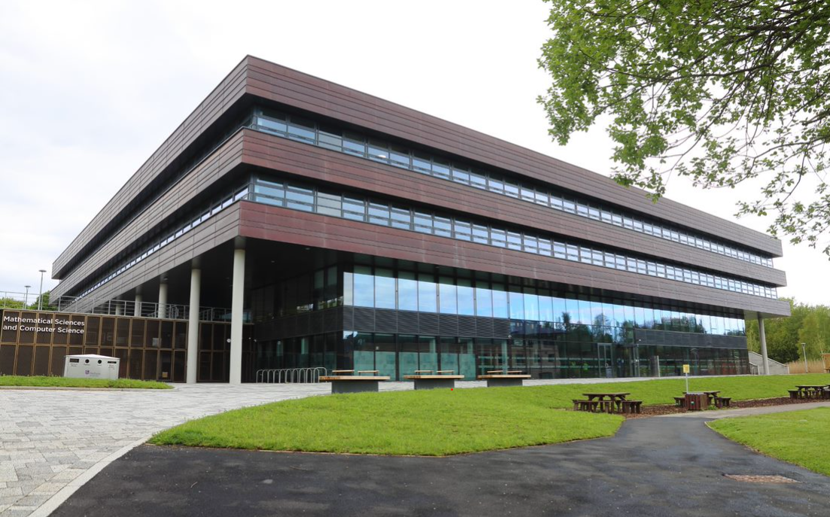
ExCALIBUR at HPC Days in Durham
Organised by Tobias Weinzierl, there was an afternoon and morning ExCALIBUR session during HPC Days held in Durham in early May
Entitled “Programming the next generation of supercomputers”
The programme did a really good job of representing the variety in the ExCALIBUR programme
Began with an overview of the H&ES programme, before following with talks from individual testbeds
DIRAC, FPGAs, Rockport and BlueField
This was then followed by a talk around the design of training from the Universe-HPC project and ARCHER2, exploring aspects including diversity
Talk around the Met Office use-case, exploring Gung Ho and LFric, along with challenges that they are facing and how some of the ExCALIBUR activities might help address these
Talks on some of the cross cutting projects, including Quantum HPC computing by the QEVEC project, and domain specific languages by the xDSL project
Keynotes from David Keyes (KAUST) and Dan Stancione (TACC)
Also involved a poster presentation component by local students, and a nice opportunity for them to see some of the ExCALIBUR activities too

Slide 6
ISC23 ExCALIBUR activities
ISC is Europe’s largest HPC conference and held in early Summer (this year in late May). Smaller than SC, it attracts around 4000 attendees and is currently held in Hamburg each year.
BoF entitled “Supercomputing and Scientific Code Coupling” run by Stephen Longshaw from STFC as part of the code coupling project
Project posters on xDSL and RISC-V testbed ExCALIBUR projects
Co-organised BoF entitled “RISC-V is HPC. Help Build Your Ecosystem”
Main conference research paper “Efficient GPU Offloading with OpenMP for a Hyperbolic Finite Volume Solver on Dynamically Adaptive Meshes” as part of the task-based parallelism and PAX-HPC projects
Involved in “Plasma-PEPSC – Pushing Flagship Plasma Simulation Codes to Tackle Exascale-Enabled Grand Challenges via Performance Optimisation and Codesign” BoF by xDSL project
“Intelligent algorithms on intelligent networks—experiences and challenges using NVIDIA’s BlueField technology” workshop paper by the task-based parallelism and Storage and RAM As A Service projects
Organised First International RISC-V for HPC workshop by the RISC-V testbed project
“Test-driving RISC-V Vector hardware for HPC” workshop paper by the RISC-V testbed project
“Backporting RISC-V vector assembly” workshop paper by the RISC-V testbed project
Partner booths holding ExCALIBUR content and discussion with attendees

Slide 8
Knowledge exchange discussion
We have around 18 months left of the programme and with individual projects all delivering exciting insights we have strong potential to have an important impact
Whilst there have been numerous KE successes and activities, especially at the project level, it’s worth looking at what we are doing and trying to understand what opportunities there are that we could better exploit
The value of having a discussion is to share everyone’s views and collect a wide range of opinions to help inform this
There are probably lots of ways of doing KE that it would be good to share
The start of this month I have taken on coordinating the ExCALIBUR KE network and-so am keen that we direct our efforts in the right way. In terms of some ideas I have:
Formalising our strategy and metrics for success around KE
Twitter presence (I have registered @uk_ExCALIBUR that we will start using)
Monthly webinar style meetings where two projects could present for around 20 mins each
Online Slack/Zulip that we can all join and enable better communication between projects
Case studies/whitepapers from projects on the ExCALIBUR programme website
Identifying strategic events that we want to have a programme level presence at
Programme level interaction with other global activities (individual projects do this well)
Notes:
Prompt – presenters to share ongoing or current barriers faced in the project that would benefit from further discussion or connecting with an individual or project could help to overcome this. This could be a technical barrier, people barrier, not being aware of good practises or needing better connections. These discussions could help push forward progress across the programme and further afield

Slide 9
https://t.ly/We0Tw
Where can we improve with KE?

