Slide 1
BASE-II (Blueprinting AI for Science at Exascale) Knowledge Exchange
Jeyan Thiyagalingam¹, Paul Calleja², Jeremy Yates³, Mark Wilkinson⁴, and Marion Samler¹,
¹Science and Technology Facilities Council, ²University of Cambridge, ³University College London, ⁴University of Leicester
Engineer’s House, 11-12 October 2023

Slide 2
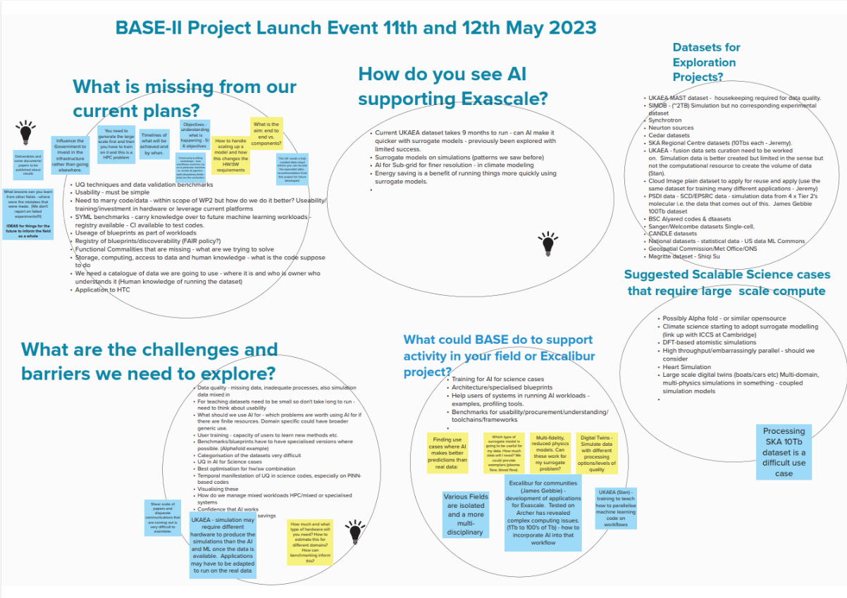
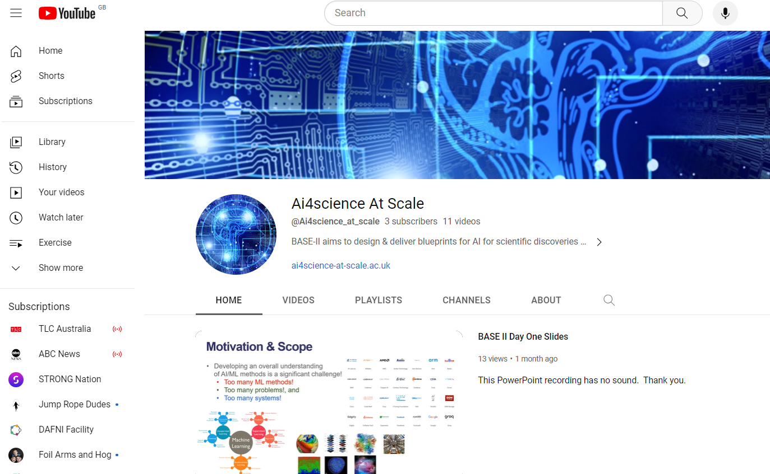
Project Status: BASE-II Project Launch - 11th and 12th May 2023 at the University of Leicester; Field Placements/visiting Scientist: Launched https://ai4science-at-scale.ac.uk/outreach-and-knowledge-exchange/outreach-and-knowledge-exchange-2/; Survey: US Labs and Excalibur Community to support knowledge for BASE-II; Seminars/Workshops delivered: and planned Training – delivered - ML for Science, Diamond Light Source & DiRAC, 18th through 22nd September 2023 Quarterly dial-ins with industry and across STFC partners
Notes:
On foundation models and autonomous discovery for biological systems engineering: Peptides, Proteins, Pathways, and Beyond, May 2023, Arvind Ramanathan (Argonne), Offered via STFC’s AI for Science Seminar Series, STFC. Data-parallelism based deep learning approach for the model order reduction of parametrized partial differential equations, September 2023, Nirav Shah (University of Cambridge), Offered via STFC’s Scientific Computing Seminar, STFC.
Benchmarking storage performance of LLMs - Jean-Thomas Acquaviva (DDN), to be offered via STFC’s AI for Science Seminar Series, Jan 2024. Benchmarking LLMs on large-scale systems - Ana Gainaru (ORNL), to be offered via STFC’s AI for Science Seminar Series, Feb 2024. Blueprinting AI for Science for Exascale (BASE-II): Community Update - Jeyan Thiyagalingam (STFC), , March 2024. Hardware and Software Co-Design for Machine Learning Workshop - Paul Calleja (University of Cambridge), April 2024. Surrogate Physical Models - Frederik De Ceuster (Institute of Astronomy, KU Leuven), to be Scheduled, June 2024. AI for Science Benchmarks – Mark Wilkinson, First Collection of Use Cases, to be Scheduled, Sep 2024.

Slide 3
Current Challenges: Bringing together the diverse range of projects to engage across each other; Finding the right ‘methods’ for communication that will support knowledge exchange across all projects; Accessing the right use cases to provide requirements for AI Blueprints!

