Slide 1





EXASCALE: what, why and how?
Notes:
This presentation is intended to put forward the rationale behind why ExCALIBUR is happening, including what exascale computing is, how modern and future supercomputers differ structurally from their predecessors and why models need to be modified to suit them. It is intended to be accessible to the general public or non-specialist.

Slide 2
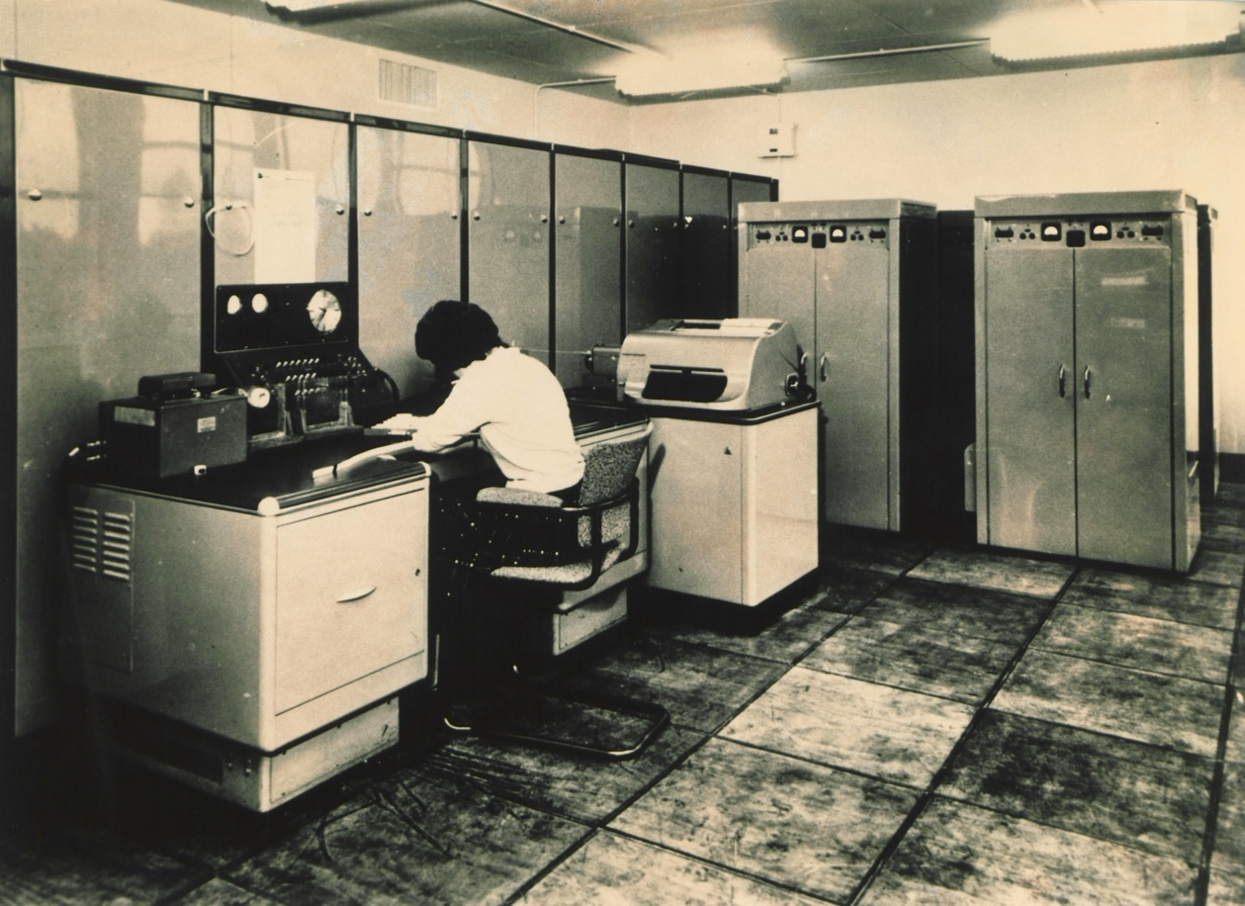
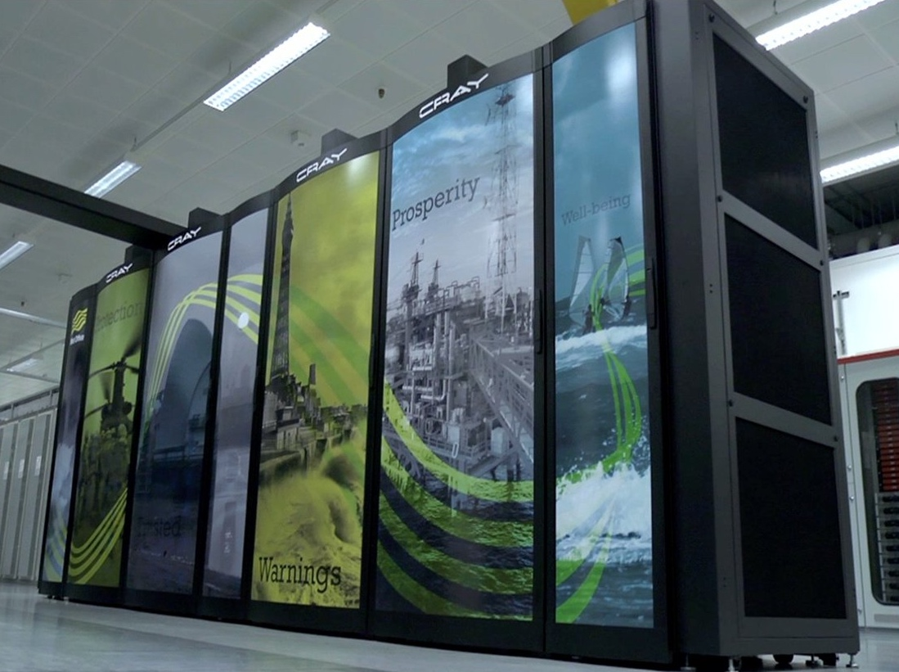

What does exascale mean?
Exascale refers to exabytes and exaFLOPS.
Bytes are a measure of data quantity. 1 exabyte is 1 x 10¹⁸ bytes (1,000,000,000,000,000,000 bytes), 1 million times more than the 1TB hard drives in many computers. Handling these huge amounts of data presents serious challenges.
FLOPS (Floating Point Operations per Second) are a measure of computer performance. Supercomputer performance has improved rapidly in recent decades. For example:
The Met Office’s first supercomputer, a Ferranti Mercury from 1959, had ~20MB of storage and was capable of ~15,000 calculations per second (~15 kiloFLOPS)
The current Cray XC40 can store 24PB of data and do 16,000,000,000,000,000 calculations per second (16 petaFLOPS)
1 exaFLOP is still over 60 times more than the XC40 is capable of.
Notes:
The new supercomputer from Microsoft is expected to give an ~18x increase in capability in its second phase.

Slide 3
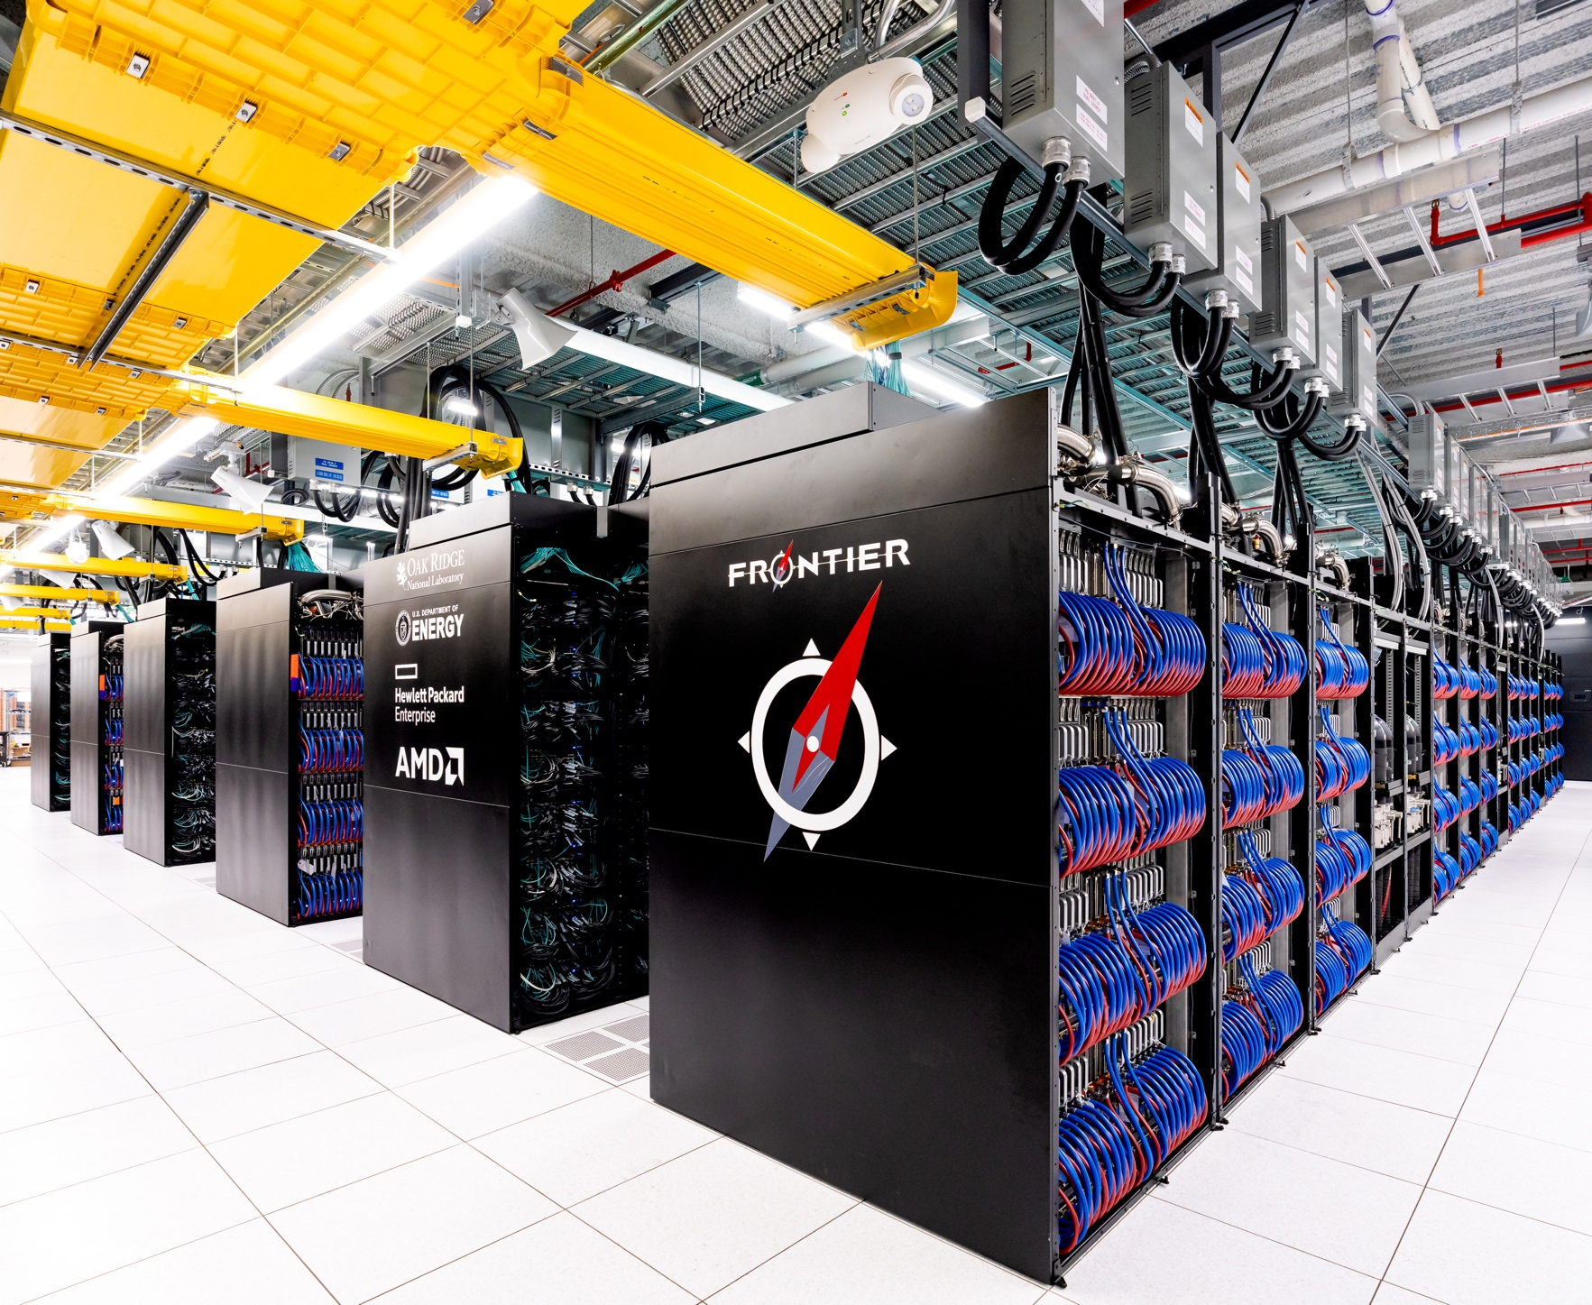
What does exascale mean?
The first exascale computer, Frontier, was completed in May 2022 in Oak Ridge, Tennessee.
Boasting 700PB of storage capacity and using a combination of CPUs (Central Processing Units) and GPUs (Graphics Processing Units), it can achieve speeds more than 60 times faster than the Met Office’s Cray XC40.
GPUs were originally made for rendering computer graphics, a job which can easily be split between many individual compute cores running in parallel on a single chip.
GPUs are now increasingly being used in a more general-purpose way, with less specialist computing tasks being adapted to run in many parallel parts.
GPUs have an advantage over CPUs in parallel tasks due to key differences in core count and clock speed…
Credit: Oak Ridge Leadership Computing Facility (OLCF)

Slide 4
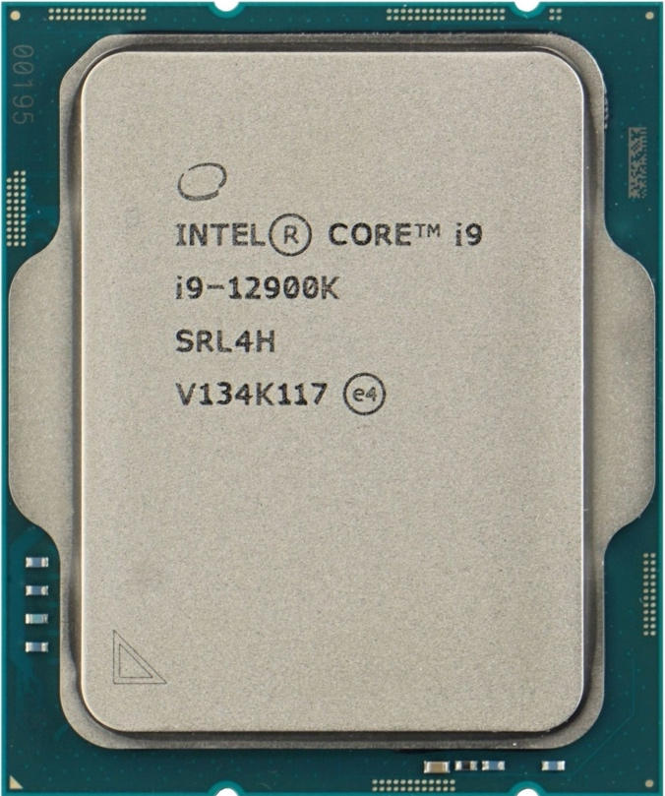

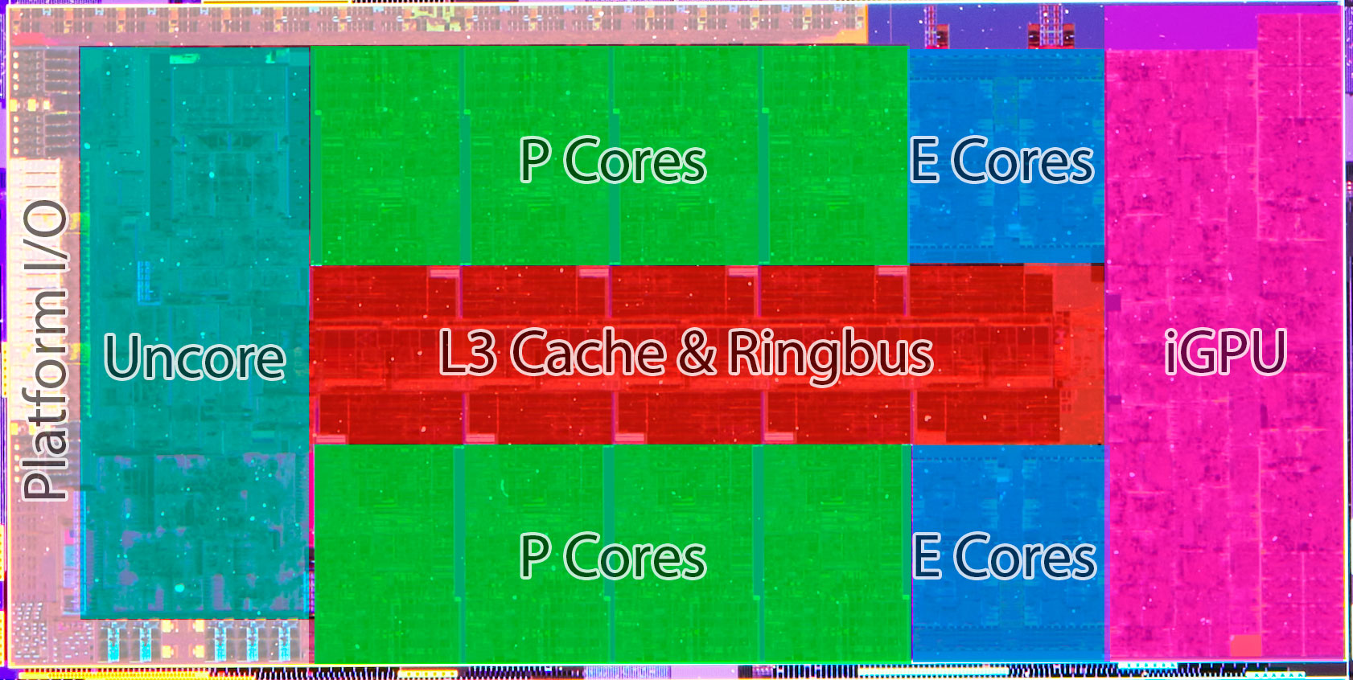
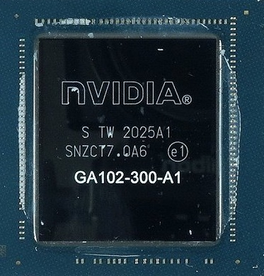
How are CPUs and GPUs different?
CPU – Intel Core i9-12900K
10 cores, max. clock speed = 5.2 GHz
GPU – Nvidia GeForce RTX 3090
11,330 cores, max. clock speed = 1.695 GHz
Notes:
Comparison of high-end desktop CPU and GPU as of late 2022.
CPUs and GPUs differ primarily in core count and clock speed.
Clock speed determines how quickly a particular core can complete a task.
Core count determines how many tasks the chip as a whole can complete at once.
GPUs have a much lower clock speed than CPUs do, however they have orders of magnitude more cores.
The Frontier supercomputer we saw earlier, using a combination of CPUs and GPUs, has nearly 9 million cores in total, compared to the Met Office’s all-CPU supercomputer’s 460,000 cores.
If a job can be broken up into many small tasks, the huge core count advantage of GPUs can outweigh their lower clock speed and allow them to complete the job much faster than a CPU.

Slide 5

Why is this a problem?
Computer models of the kind used for weather forecasting and physical simulations are built to run on CPU-based supercomputers.
This means they can’t use the many parallel cores of GPUs very effectively.
We don’t know for sure what supercomputers will look like in the future, but they are likely to include multiple different types of processors. Some modern CPUs are even incorporating GPUs onto them in one chip.
Cloud-based technology has been considered, particularly for the problems of storing exabytes of data, however this may not have the scale or the speed to supply data to processors well enough. This results in severe efficiency losses, though it will probably be used in next-gen supercomputing in some form.

Slide 6

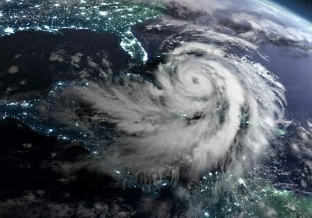
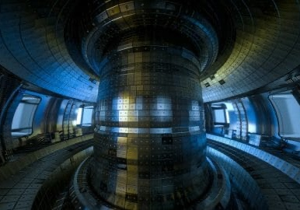
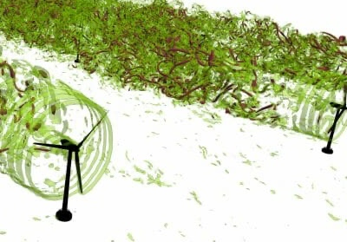
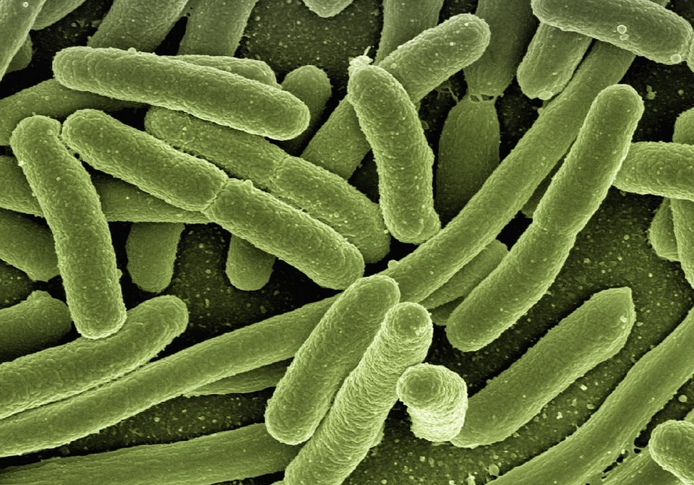

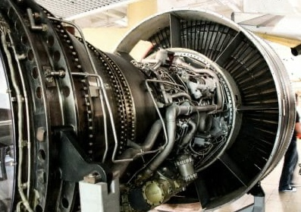
Why is this a problem?
Adapting high-end computer models to run on the next-generation architecture of exascale computers would benefit all kinds of applications using these models.
Weather and climate modelling
Enhanced computing power will help provide more accurate weather forecasts, including extreme event warnings, as well as projections of the changing future climate.
Nuclear fusion research
Physicists use supercomputers to better understand the behaviour of plasma inside prototype fusion reactors, which could provide low-carbon power for millennia to come.
Particle physics and fluid dynamics
Better simulations of turbulence in fluids, such as air and water, could lead to more efficient wings and turbines, benefitting the renewable energy and aviation industries.
Medicine
Improved supercomputing power can more accurately simulate chemical and biological processes inside bacteria, helping understand antibiotic resistance.
Astrophysics
High-powered supercomputers allow astronomers to simulate complex phenomena such as the movements of stars within galaxies, or what happens in the centre of stars.
Engine design
Simulations help engineers model how heat flows inside engines. This can reveal areas where efficiency can be improved, leading to better fuel consumption or operating characteristics.

Slide 7

Enter ExCALIBUR
Exascale Computing ALgorithms & Infrastructures Benefiting UK Research (ExCALIBUR) is a UK research programme that aims to deliver the next generation of high-performance simulation software for the highest-priority fields in UK research.
£46 million from the Strategic Priorities Fund will deliver research managed by several organisations in the Public Sector Research Establishment and UK Research & Innovation from October 2019 to March 2025:
Met Office
UK Atomic Energy Authority
EPSRC - Engineering and Physical Sciences Research Council
MRC - Medical Research Council
NERC - Natural Environment Research Council
STFC - Science and Technologies Facilities Council
Many other individual partners and grant holders

Slide 8
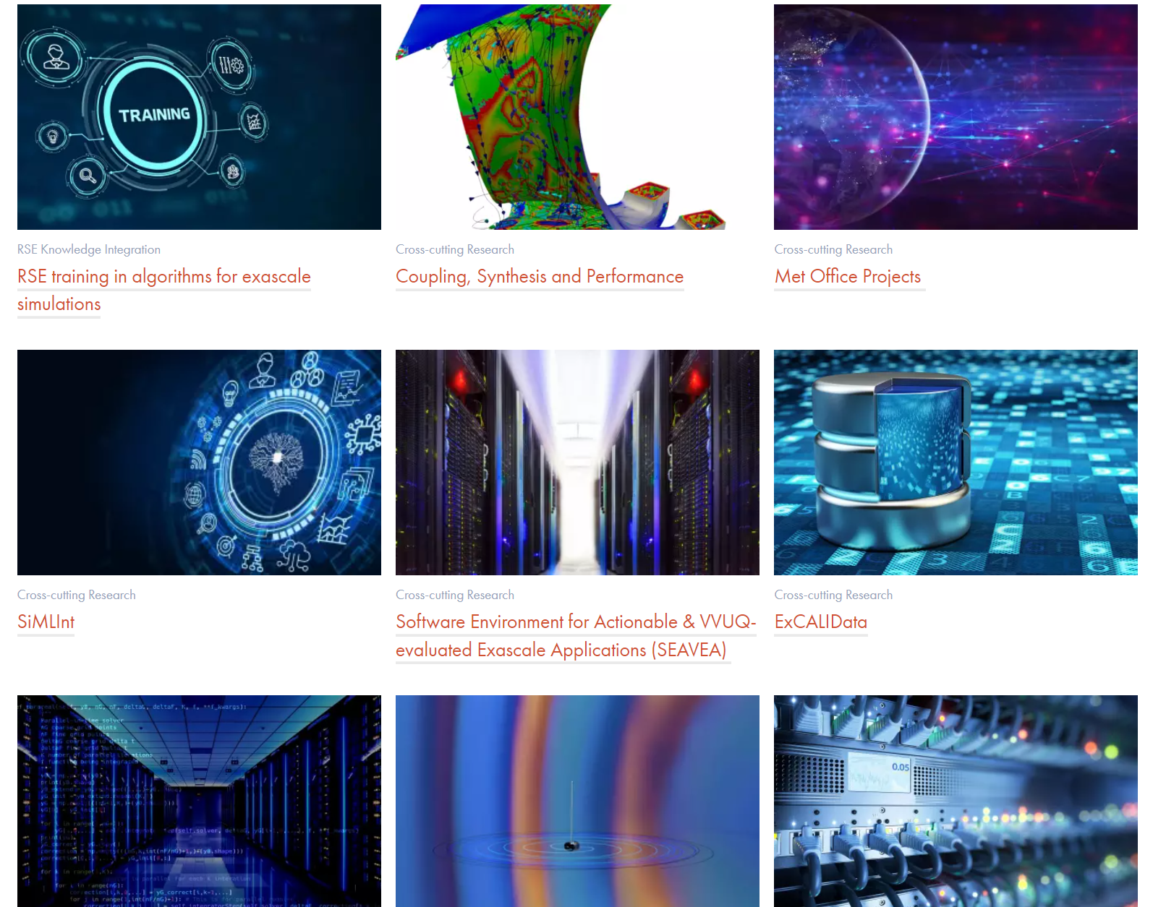
Enter ExCALIBUR
The project is split into several sets of use cases, each researching a particular topic but also demonstrating benefits for other use cases.
Working collaboratively, different organisations can improve exascale modelling for the benefit of all.

Slide 9

Thank you

