Slide 1
Hardware & Enabling Software
Martin Hamilton
ExCALIBUR H&ES Programme Co-ordinator
m@martinh.net
Engineer’s House, 11-12 October 2023

Slide 2
Hardware & Enabling Software – Overview
H&ES - £4.5M or roughly 10% of the overall ExCALIBUR budget, ring-fenced for horizon scanning and technology foresight
Funded projects working on hardware testbeds, e.g. RISC-V, FPGA, Rockport, AMD and Intel GPUs, BlueField DPUs, Cerebras and Graphcore AI accelerators, D-WAVE quantum computing
Enabling software includes Arm Forge debugging, Breeze/Mistral performance monitoring, DAOS NVMe object store, Exascale Benchmarking, porting toolchains and key codes like ParaView
Projects are generally small scale / experimental, not part of business-as-usual service provision
Find out more at 1345 session today, and hear from several of the projects represented
https://excalibur.ac.uk/theme-archive/hardware-and-enabling-software/
Notes:
Prompt - presenters should provide a brief reminder (or introduction for new projects) of their project within the talk and direct attendees to posters for further information.

Slide 3
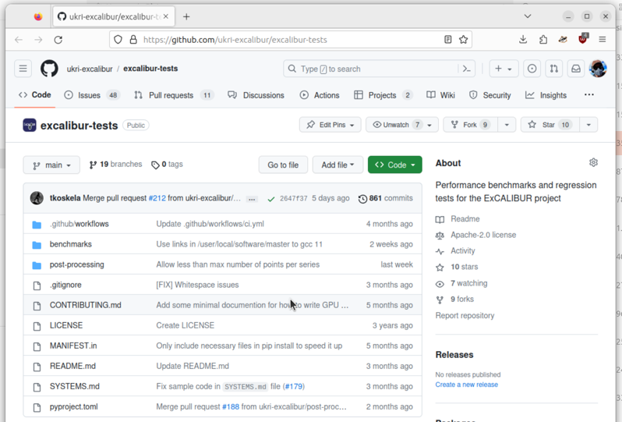
Hardware & Enabling Software – KE Highlights
Presentations, posters, workshops and Birds of a Feather sessions at key national and international events including SC, ISC, CIUK, HPC-AI Advisory Council and UK RSE Conference
Project websites – most projects have a website with details of access arrangements, documentation and support available
Publications – technical reports from individual projects (usually available from their websites), with re-prints and peer reviewed publications starting to appear
Some dedicated training, standalone and as part of events / in collaboration with technology providers
Media coverage – e.g. HPCwire, Scientific Computing World, insideHPC, The Next Platform
Sample project output – Exascale Benchmarking suite open source project: https://github.com/ukri-excalibur/excalibur-tests
Notes:
Prompt - presenters should provide a brief reminder (or introduction for new projects) of their project within the talk and direct attendees to posters for further information.

Slide 4
Hardware & Enabling Software – Current Challenges
Time-limited nature of ExCALIBUR project funding + capital structure of the grants adds significant friction to resourcing staff effort
Some delays experienced with project startup, impacting on recruitment / retention / assignment of people with the required skills to projects
Cognitive dissonance between people’s expectations of service provision and training versus reality of experimental testbed settings
Calibrating expectations around access to cutting edge hardware versus commercial sensitivities
Supply chain uncertainties / product strategy changes have impacted on project delivery
“Are we the baddies?” (see graphic)
Climate Stripes graphic CC-BY Ed Hawkins, University of Reading. Generate your own: https://showyourstripes.info/
Notes:
Prompt - presenters should provide a brief reminder (or introduction for new projects) of their project within the talk and direct attendees to posters for further information.

